Slide 1
Objectives
In this session, you will learn to:
  Understand the role of inventory
  Understand cash and credit purchases and differentiate between them
  Understand cash and credit sales and differentiate between them
  Identify the process of purchase and sales returns
  Understand the applications of bills of exchange
  Understand the principles of revenue recognition and the concept of price levels
  Generate and print accounting and inventory reports
Notes:
Share the session objectives with the students.

Slide 2
Understanding the Role of Inventory
Inventories are assets:
  Held for sale in the course of business.
  In the process of production for such sale.
  In the form of materials or supplies to be consumed in the production process or in the rendering of services.
Notes:
Share the session objectives with the students.

Slide 3
Understanding the Role of Inventory (Contd.)
Kinds of inventory:
  Raw materials: Are the items purchased for use in the production process, they are modified or transformed into the final product.
  Work-In-Progress (WIP): Is the value of party finished goods.
  Finished goods: Is that portion of goods, which is manufactured and available for sale.
  Supplies: Are items consumed in the normal functioning of a firm that are not part of the final product.
Notes:
Share the session objectives with the students.

Slide 4
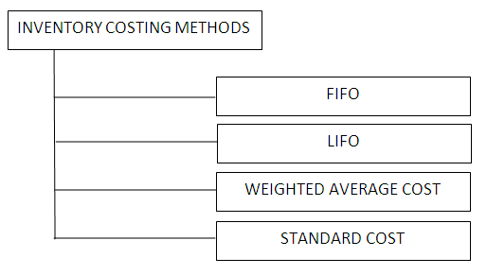
Understanding the Role of Inventory (Contd.)
The following figure shows the inventory costing methods.
Notes:
Share the session objectives with the students.

Slide 5
Understanding the Role of Inventory (Contd.)
There are two inventory systems:
  Quantity vs. Value Records
  Periodic and perpetual inventory systems
Quantity vs. Value Records:
  Are used to record the movement of a stock.
  Maintains inventory at factory or godowns which are strategically located to achieve timely delivery and reduce cost of holding.
Notes:
Share the session objectives with the students.

Slide 6
Understanding the Role of Inventory (Contd.)
Periodic and perpetual inventory systems:
  Periodic inventory system:
    Is a method where the physical inventory is usually taken only at the year end or at regular intervals, to determine closing stock and cost of goods sold.
    Is applicable in organizations where the cost of recording stock movement outweighs the benefits of recording and updating stock status.
  Perpetual inventory system:
    Is a method where the inventory accounting is kept up-to-date.
    Involves the recording of receipts to delivery of materials on a daily basis.
    Is applicable to businesses where there are a number of sales transactions everyday and the sales are of high value.
Notes:
Share the session objectives with the students.

Slide 7
Understanding Cash and Credit Purchases and Differentiating Between Them
Cash purchase:
  When payment is made on a purchase instantly, either by cash or cheque.
Credit purchase:
  When the payment is made on a purchase upon a later date as the date of payment for goods purchased.
Notes:
Share the session objectives with the students.

Slide 8
Understanding Cash and Credit Sales and Differentiating Between Them (Contd.)
Cash sale:
  When payment is received on goods sold instantly, either by cash or cheque.
Credit sale:
  When the payment is made on a sale upon a later date as the date of payment for goods sold.
Notes:
Share the session objectives with the students.

Slide 9
Identifying the Process of Purchase and Sales Returns
Good purchased can be returned to a supplier if the goods are not according to the terms and conditions agreed upon by the buyer and the supplier.
At the time of return of goods (from the buyer’s perspective), a document called debit note is prepared.
A debit note:
  Is a note that indicates and accounts for an amount owned by a person or a company.
  Can be issued when:
    The buyer does not agree with the sales invoice of the supplier booking the purchases.
    The supplier intimates the buyer that an interest is due for delayed payments.
    The suppliers accounts for and intimates the buyer that expenditures incurred on his behalf is recoverable.
Notes:
Share the session objectives with the students.

Slide 10
Identifying the Process of Purchase and Sales Returns (Contd.)
Good purchased can be returned to the supplier by the buyers if the goods supplied are not according to the terms and conditions agreed upon the buyer and the supplier.
At the time of return of goods (from the supplier’s perspective), a document called credit note is prepared.
A credit note:
  Is a note that acknowledges and accounts for an amount owned by a person or a company.
  Can be issued when:
    The supplier acknowledges the goods returned by the buyer.
    The buyer acknowledges to the supplier that interest is due for delayed payments.
    The buyer acknowledges the reimbursement of expenditure incurred by the supplier on his/her behalf.
Notes:
Share the session objectives with the students.

Slide 11
Understanding the Applications of Bills of Exchange
Bill of Exchange:
  Is an instrument in writing, containing an unconditional order, signed by the maker (drawer), directing a certain person (drawee) to pay a certain sum of money only to, or to the order of, a certain person or to the bearer (payee) of the instrument.
  Must be accepted by the drawee as well as dated and property stamped.
  Can be treated as both bills receivable and bills payable.
Notes:
Share the session objectives with the students.

Slide 12
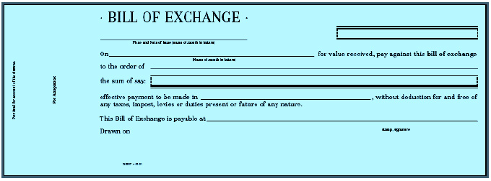
Understanding the Applications of Bills of Exchange (Contd.)
The following figure shows the specimen of bill of exchange.
Notes:
Share the session objectives with the students.

Slide 13
Understanding the Principles of Revenue Recognition and the Concept of Price Levels
As per the principles, revenues can be recognized when:
  Significant risks and reward of ownership of goods are transferred to the buyer.
  Seller retains no effective control over the goods usually associated with ownership.
  No significant uncertainty exists regarding the amount of consideration to be received.
Notes:
Share the session objectives with the students.

Slide 14
Understanding the Principles of Revenue Recognition and the Concept of Price Levels (Contd.)
Products are sold in different markets for different prices and to different customer segments based on the demand and supply for the product and competition from other organizations dealing in similar products.
The diversity followed in assigning different values for the same product is known as setting up of price levels.
The price level feature in Tally.ERP 9 allows setting up of different price lists for the same items.
Notes:
Share the session objectives with the students.

Slide 15

Generating and Printing Accounting and Inventory Reports
Notes:
Share the session objectives with the students.

Slide 16
Generating and Printing Accounting and Inventory Reports (Contd.)
Reports and documents generated through Tally.
ERP 9’s extensive display capabilities can also be printed.
Printing can be done in two ways:
  Using the print button
  Multi-account printing
Common printing options affect the printing of all reports and are changed by selecting the appropriate button from the button bar.
Notes:
Share the session objectives with the students.

Slide 17
Generating and Printing Accounting and Inventory Reports (Contd.)
Common printing options are:
  Print language
  With Preview
  Titling
  Page Nos
  Pre-defined/ Plain Paper
  Print Format
  Copies
  Printer
Notes:
Share the session objectives with the students.

Slide 18
Summary
In this session, you learned that:
  Inventories are assets:
    Held for sale in the course of business.
    In the process of production for such sale.
    In the form of materials or supplies to be consumed in the production process or in the rendering of services.
  Kinds of inventory:
    Raw materials
    Work-In-Progress (WIP)
    Finished goods
    Supplies
  Inventory costing methods:
    FIFO
    LIFO
    Weighted Average Cost
    Standard Cost

Slide 19
Summary (Contd.)
  There are two inventory systems:
    Quantity vs. Value Records
    Periodic and perpetual inventory systems
  Cash purchase is when payment is made on a purchase instantly, either by cash or cheque.
  Credit purchase is when the payment is made on a purchase upon a later date as the date of payment for goods purchased.
  Cash sale is when payment is received on goods sold instantly, either by cash or cheque.
  Credit sale is when the payment is made on a sale upon a later date as the date of payment for goods sold.
  A debit note is a note that indicates and accounts for an amount owned by a person or a company.
  A credit note is a note that acknowledges and accounts for an amount owned by a person or a company.

Slide 20
Summary (Contd.)
  Bill of Exchange is an instrument in writing, containing an unconditional order, signed by the maker (drawer), directing a certain person (drawee) to pay a certain sum of money only to, or to the order of, a certain person or to the bearer (payee) of the instrument.
  The diversity followed in assigning different values for the same product is known as setting up of price levels.
  Common printing options affect the printing of all reports and are changed by selecting the appropriate button from the button bar.

